Slide 1


CSA0624– Design And Analysis Of Algorithms Best, Average, and Worst Case Analysis of Binary Search
SIMATS ENGINEERING
Saveetha Institute of Medical and Technical Sciences
Chennai-602105.
Presented by:
Aryan Arun
192411157

Slide 2
Introduction
Binary Search is an efficient searching algorithm for sorted arrays.
It repeatedly divides the search space into two halves.
The goal is to analyze its performance under different input conditions.
Performance is measured using Best Case, Average Case, and Worst Case with asymptotic notations.
Input Condition
✅ Array must be sorted

Slide 3
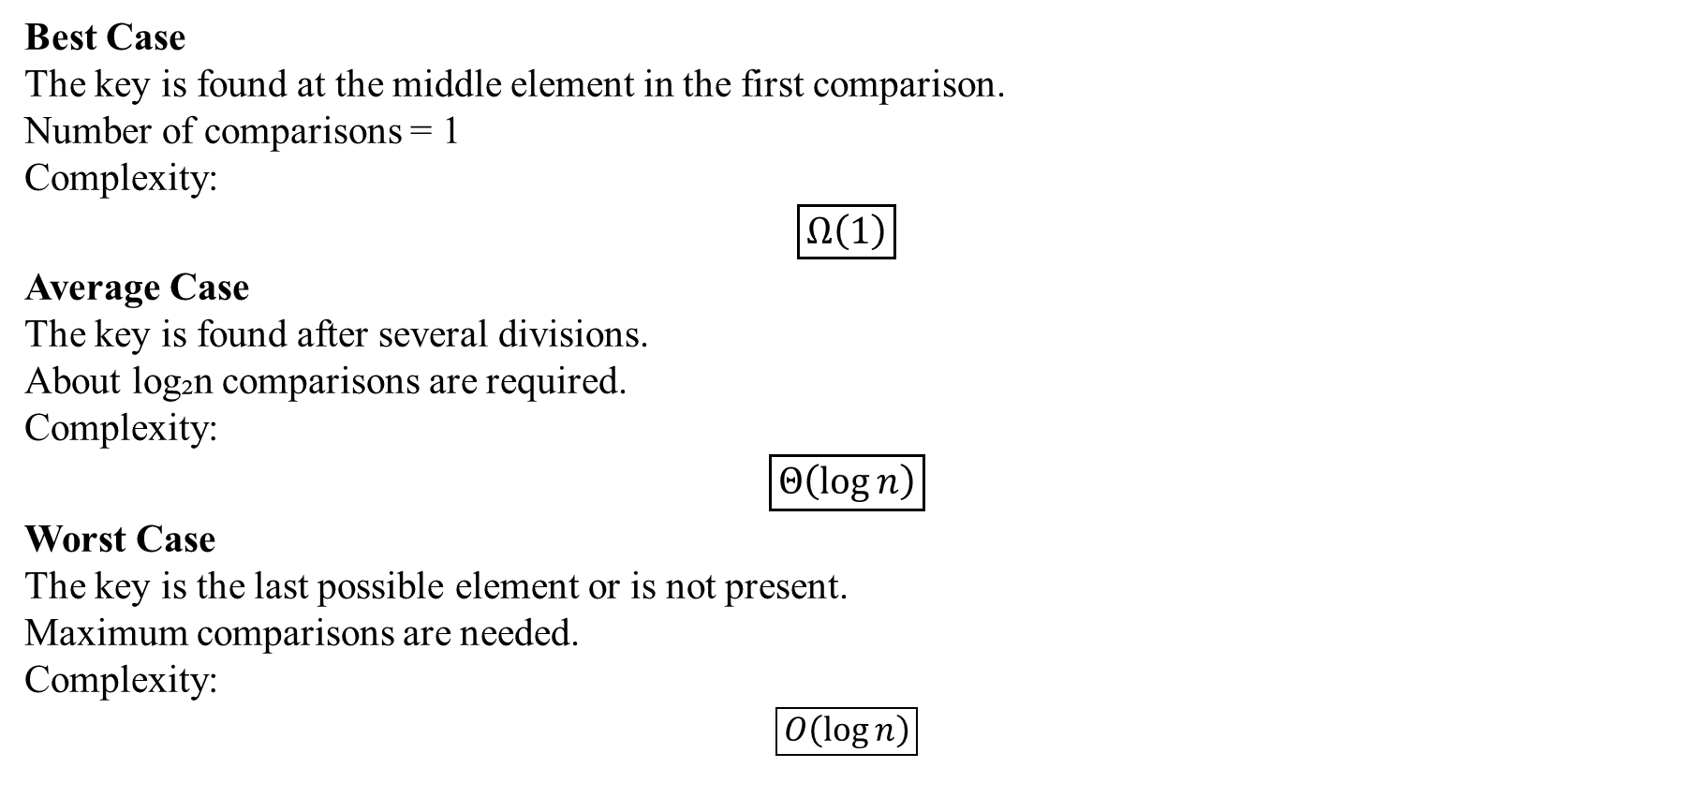
Case Analysis
Best Case
The key is found at the middle element in the first comparison.
Number of comparisons = 1
Complexity:
$$\boxed{Ω\left(1\right)}$$
Average Case
The key is found after several divisions.
About log₂n comparisons are required.
Complexity:
$$\boxed{Θ\left(\log{n}\right)}$$
Worst Case
The key is the last possible element or is not present.
Maximum comparisons are needed.
Complexity:
$$\boxed{O\left(\log{n}\right)}$$

Slide 4
Performance Comparison
Case | Condition | Complexity
Best | Element at middle | Ω(1)
Average | Element after several divisions | Θ(log n)
Worst | Element absent or last checked | O(log n)
Observations
Search space is reduced by half after every comparison.
Number of comparisons grows very slowly.
Binary Search performs efficiently even for large datasets.

Slide 5
Conclusion
Why is Worst Case Important?
Real-World Importance
Worst-case analysis guarantees the maximum running time.
It helps estimate system performance under difficult conditions.
Used in software where response time is critical.
Final Conclusion
Best Case → Ω(1)
Average Case → Θ(log n)
Worst Case → O(log n)
Key Insight
Binary Search remains one of the fastest searching algorithms because its complexity increases logarithmically rather than linearly.

